Slide 1
CS 520 - NoOp Group
Final Presentation
Detailed Document Link
Github repository
Jai Puro
Nidhi Chandra
Pragya Sarda
Saksham Kumar
Notes:
Pragya
The detailed document is linked in the slide

Slide 2
Problem Statement - Development EleNA Elevation-based navigation system
Current navigation systems do not consider elevation as a factor when calculating a route
Different users may prefer different elevation gains when choosing a route
Design a system that maximizes/minimizes elevations gains between two locations
Also constraints the calculated route to a certain percentage of the shortest route.
Notes:
Pragya : We liked the problem as this is not something which Google / Apple maps does in general. Also, this project will give us a chance of applying A* and Dijkastra algorithm to a real life problem instead of mugging it for an interview.

Slide 3
Design
A web app that takes as input
The source and destination
User's choice of whether they wish to maximize or minimize elevation gains
Limit on the percentage of deviation from the shortest route.
Transport type - walk, bike or drive
This application will use:
React on the front-end.
Flask server and Python services on backend.
OSMnx library for the geolocation data (generate city map and fetch lat-long for addresses)
Open Elevation API to determine the elevation at a certain latitude and longitude.
Google Maps API to determine the elevation at a certain latitude and longitude.
Notes:
Saksham

Slide 4
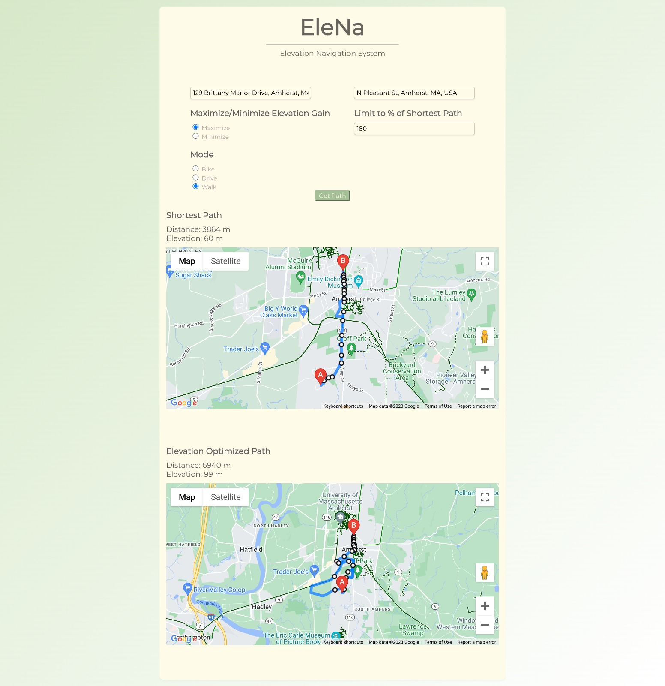
UI Design
Notes:
The proposed app will have the following features:
Input fields for entering the source and destination
Radio buttons to select min/max elevation gains
Slider to enter the limit on percentage of the shortest route
Two maps to showcase the shortest route and the new calculated route
Result window showing the total calculated distance and elevation of the route

Slide 5
Stakeholders and User Stories
Users - Runners/Joggers, Hikers, Bikers/Cyclists, Pedestrians
Developers - Designers, Programmers, Testers
As a user, I want to be able to enter my source and destination locations
As a user, I want to be able to set the elevation gain to maximum or minimum
As a user, I want to limit the length of the path to a certain fraction of the shortest path
As a user, I want to be able to see what my shortest path looks like for comparison
As a user, I want to see what the total distance between my entered locations is
As a user, I want to see the total elevation between my entered locations is

Slide 6
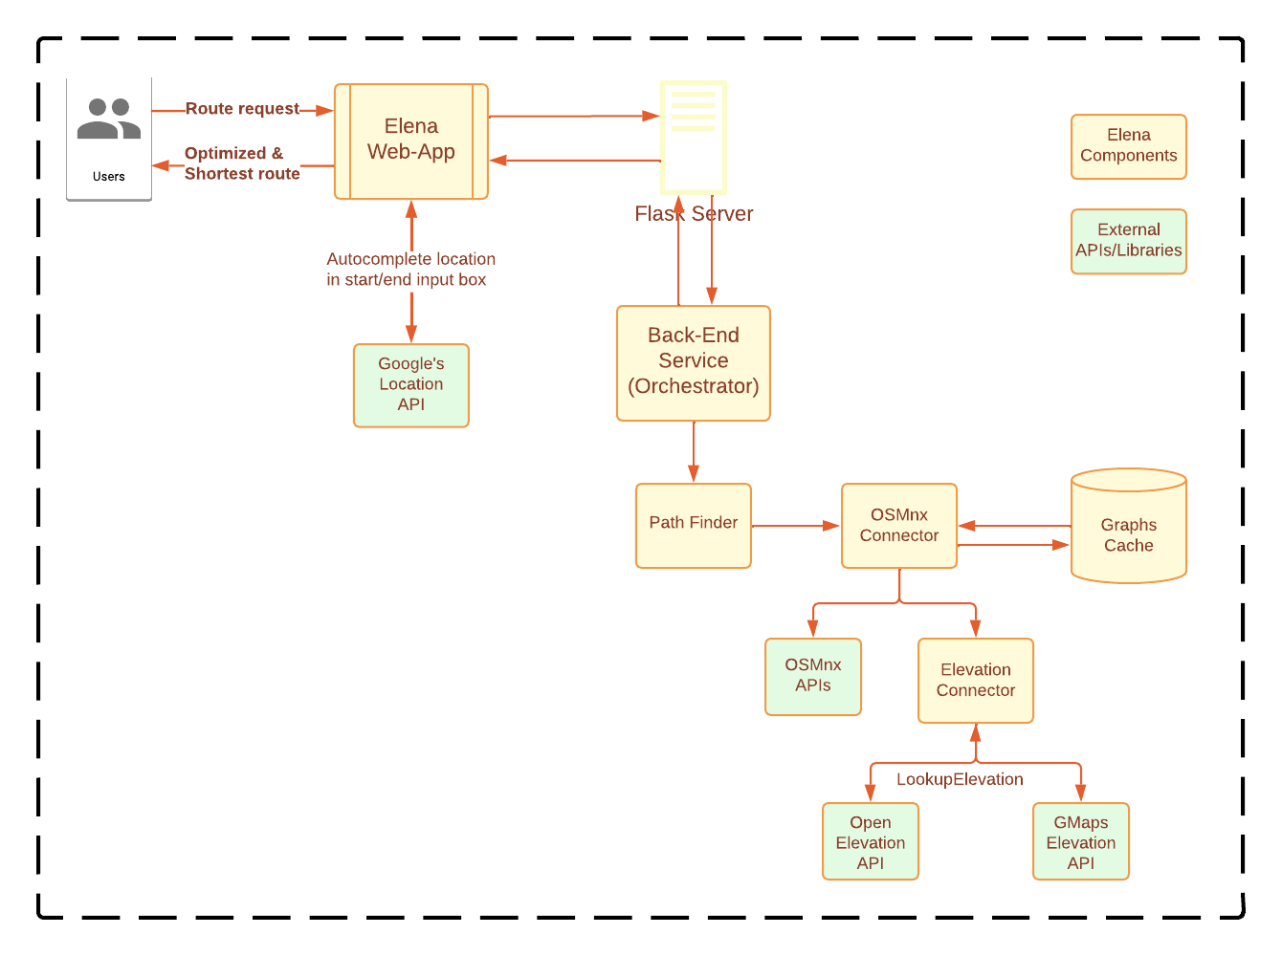
Architecture
Notes:
Pragya There is a Web-app, the client facing part of the application. As explained in the mockup slide, it allows users to enter the start and end location, what kind of elevation gain does he/she want and how much of it can deviate from the shortest route possible. The optimized route is rendered on this webapp.
Back-end Service: The backend service is the main brain of the application. It takes the user input from the UI, requests data from the libraries such as open elevation to create a route between the required locations with specific constraints. It will apply A* and/or Dijkstra's algorithm to compute the new optimized route. We will have various subcomponents like path finder and map generator to ensure modularity. The data for a given request will be stored in in-memory objects. This includes request and response from all APIs required to compute the new path.
After experimentation with various APIs provided by platforms such as Google Maps, Open Elevation and the 2 algorithms we will determine how to compute the optimized route and render the map. Thus the component diagram may change.

Slide 7
Evaluation Plan
A test plan document which consists of all test cases (including edge cases) for each functionality (per class/function) as well as all integration tests to ensure that the system is working as expected.
Unit Tests - We have line and branch coverage of more than 85% to ensure that all functionality is individually tested.
Integration and UI Tests - Cover end-to-end testing of all components based on the test plan manually and using postman. We also use alpha/beta testing by sharing the application with our friends (not enrolled in the class).
Written code following peer programming paradigm to ensure the code is well-written. We did code reviews as a part of it.
We conducted usability surveys with our friends to ensure the app is working as expected and gather feedback.
Notes:
saksham

Slide 8
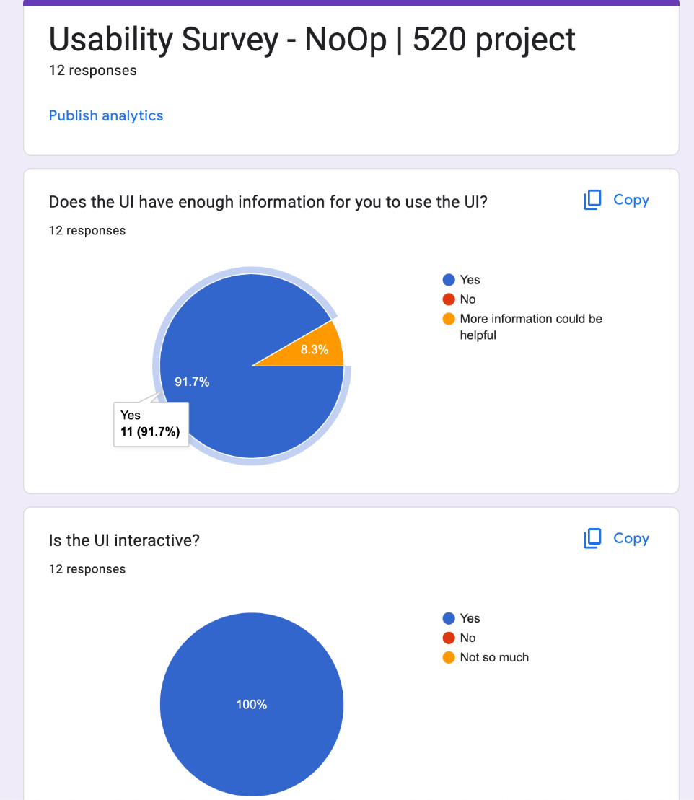
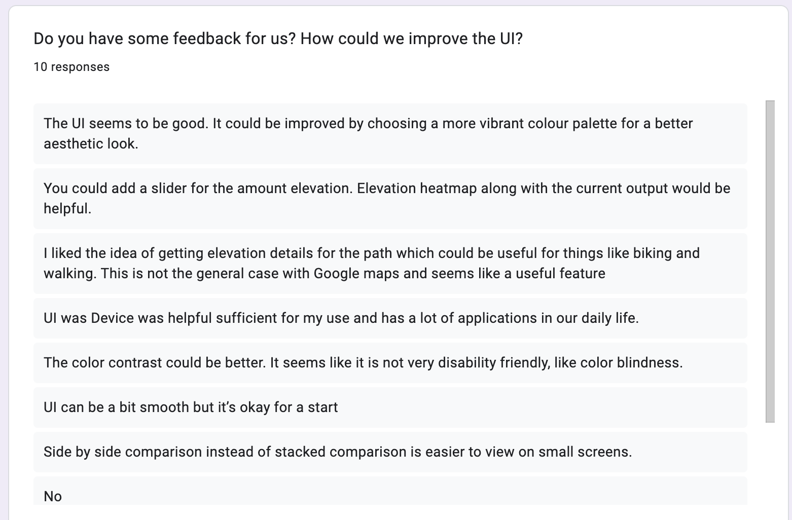
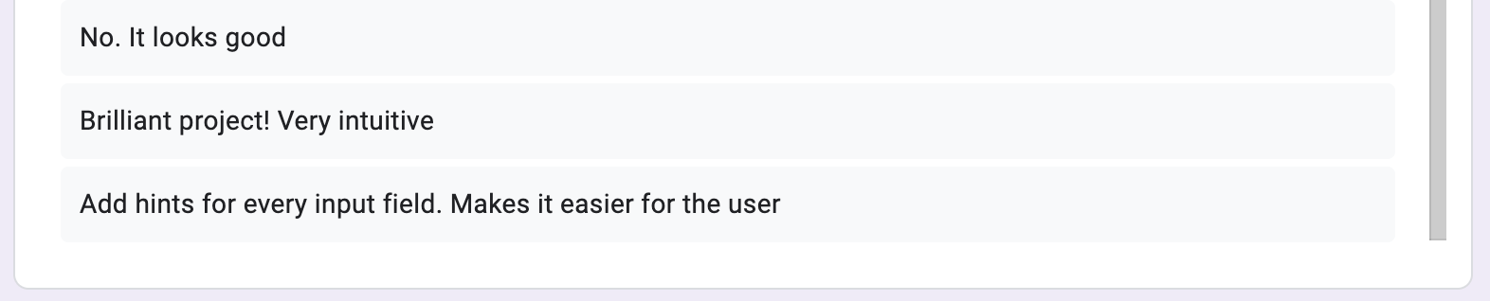

Slide 9
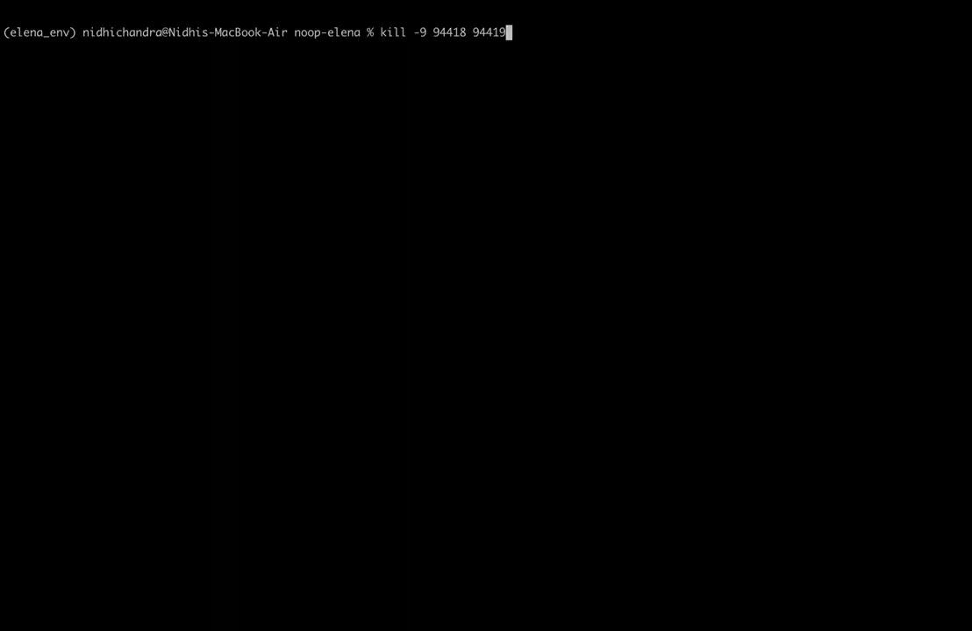
Demo
Success
Notes:
Demo

Slide 10
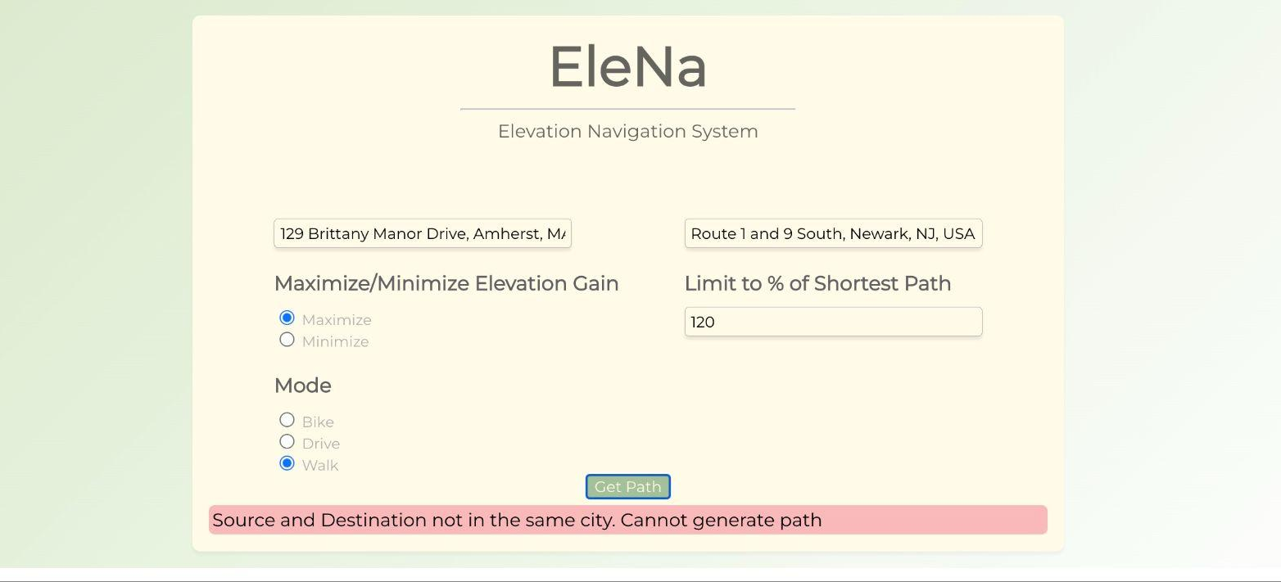
Demo - Error Case

Slide 11
Contributions
Design - All team members
UI Mockup - Jai
Architecture - Pragya
Algorithm Design - Saksham
Evaluation Plan - Nidhi
UI development - Jai Puro
Backend-Development - Saksham, Pragya
Path finding algorithms, interacting with libraries such as OSMnx, Google Maps, Open-Elevation, etc.
Integration - All team members
Evaluation and testing - Nidhi
Project Report and Documentation - All team members
Because of peer programming each group member was involved in all the components of the application.
Notes:
Saksham Note: Front-end and back-end development can be done in parallel, Similarly testing and integration effort can be done in parallel.
Because of peer programming each group member will be involved in all the components of the application.

